Slide 1
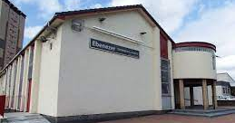

Welcome to Ebenezer
Evangelical Church
June 2025

Slide 2
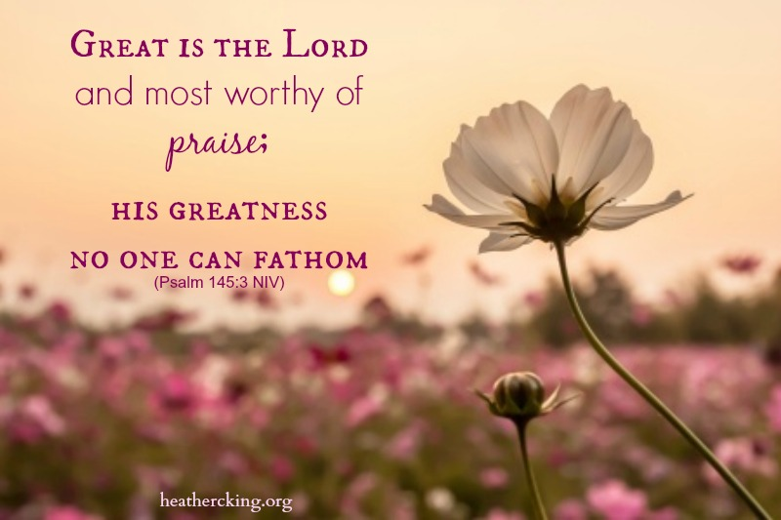

Slide 3
Sundays in june
OPEN
Robert Lawrie
Hugh Mitchell
Hugh Reid
Alan Russell
Ken Cunningham
Jamie McIlree
Robert Lawrie
Simon Snodgrass
Gareth James
Stuart Boles
Angus Mathie
Ian Robertson
Simon Snodgrass
HOLIDAY – no service
1st June
8th June
15th June
22nd June
29th June

Slide 4

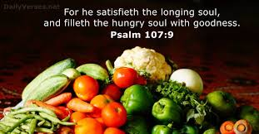
Every Monday from 10.30 am

Slide 5
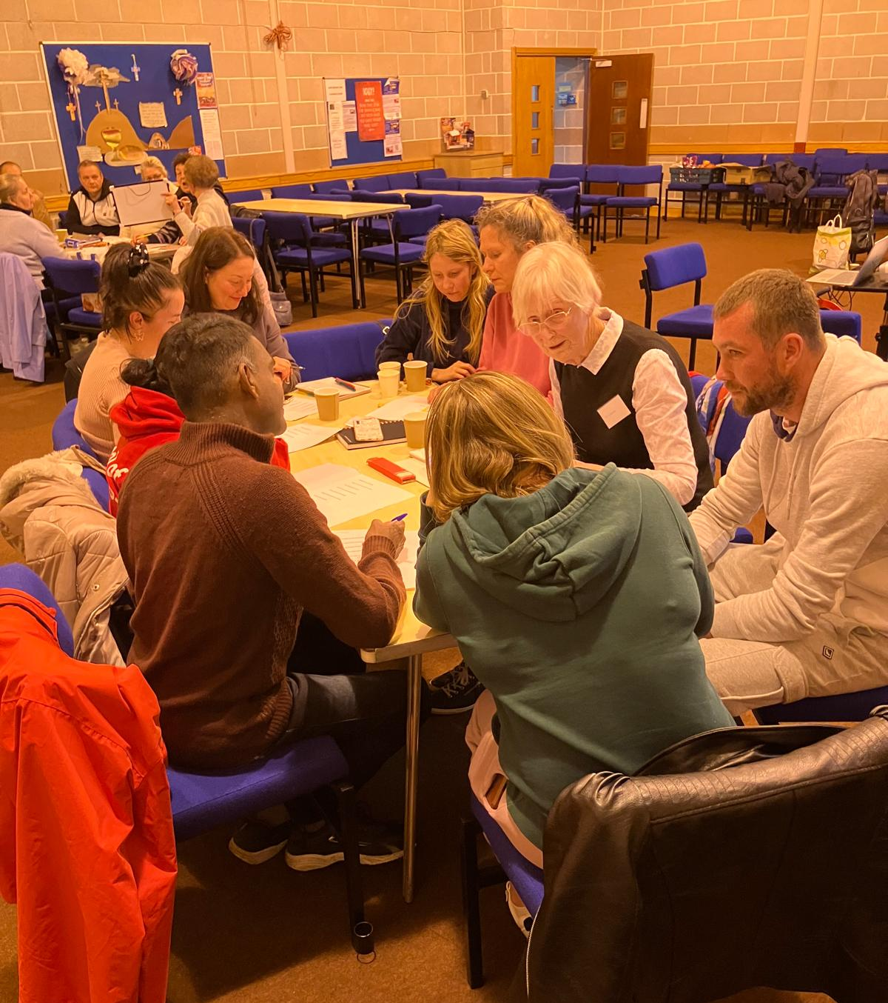
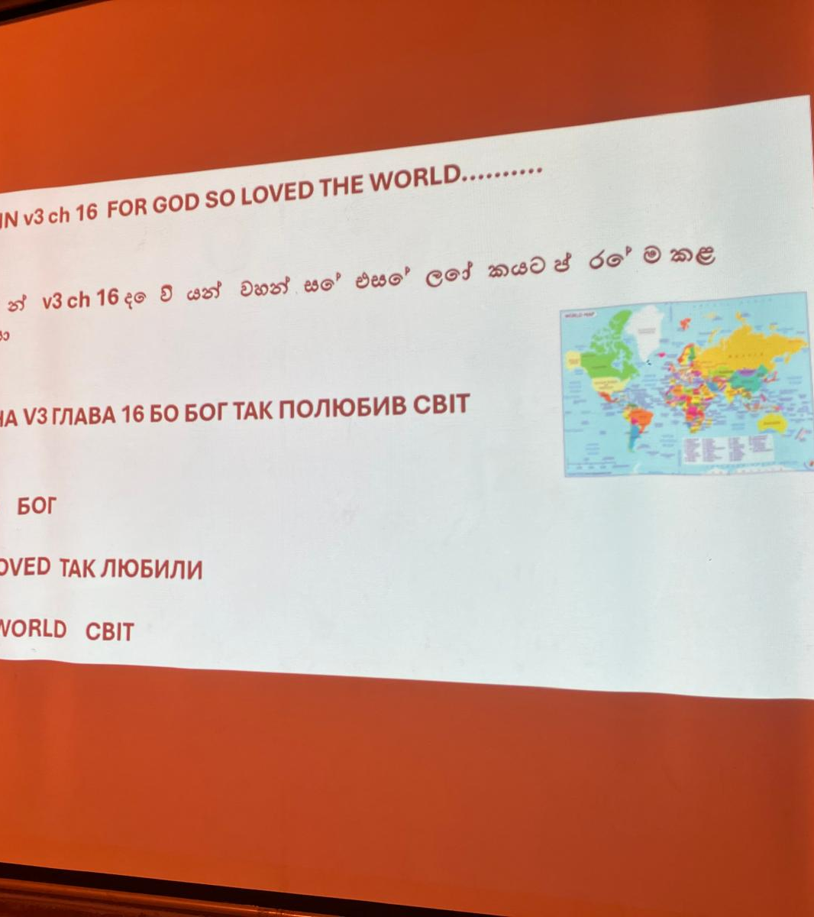
English Lessons
(with a gospel message)
Every Tuesday from 6.30pm

Slide 6


Wednesday’s
Date | Responsibility of
4th June | Robert Lawrie
11th June | Alan Russell
18th June | Robert McGilivray
25th June | Willie Glen
Tea/Coffee and chat
From 7pm
From 7.30pm

Slide 7
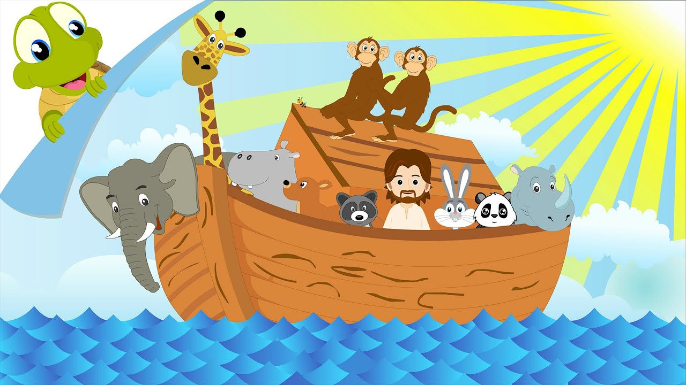
Noah’s Ark Toddlers Group, Fridays @ 10am

Slide 8
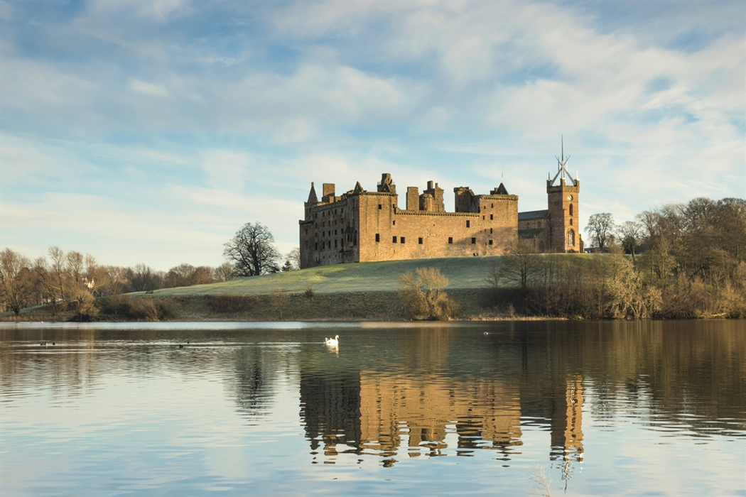
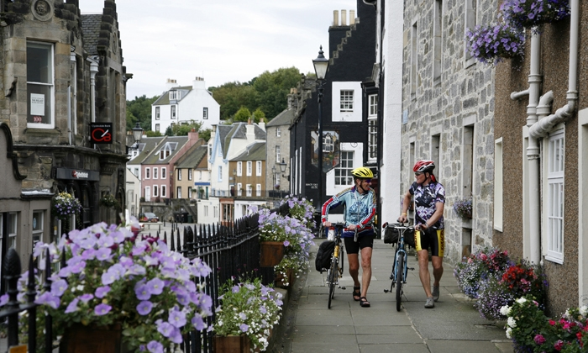
Biscuit and a Blether Away Day
11th June @ 10am

Slide 9

Biscuit & a Blether
Wed 14th May
10.30 am -12 pm

Slide 10
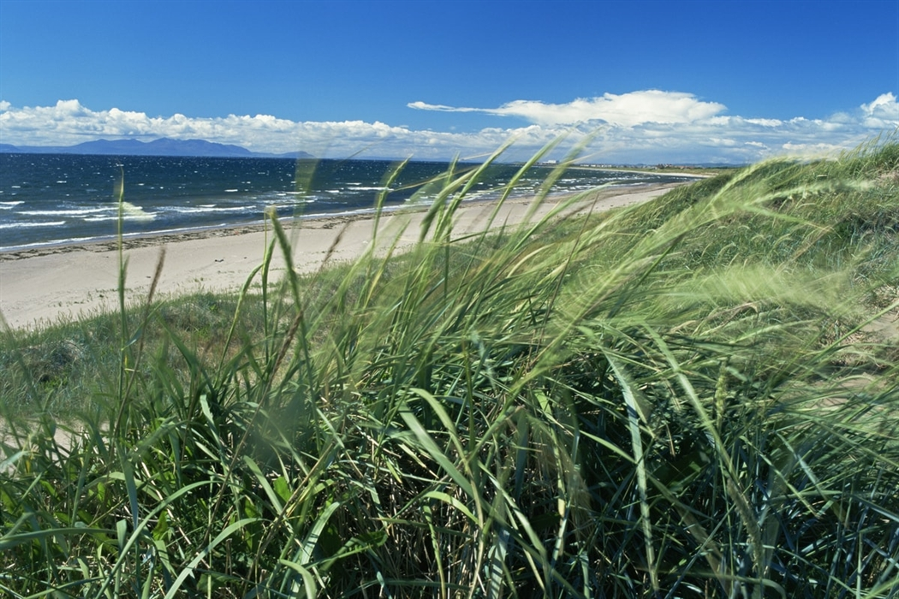
Church Away Day
Saturday 21st June; leave Church 10am
£25 – Sign Up Sheet in foyer

Slide 11

Sunday Kidz
PRIZEGIVING
Family Service
22/06/2025

Slide 12


Slide 13

FRANCE
Philippe & Marie Christine
We hope this letter finds you well and encouraged in your walk with the Lord. As we step into June, we want to share with you several points of thanksgiving and prayer concerning the ministry here in Aix, Marseille and the surrounding region.
Praise Points:
• We are thankful for the upcoming inauguration of the new CEP Marseille facilities. The church has been hosting 60 team members for a special week of evangelism and celebration. Please join us in thanking God for this new chapter!
• We’re also grateful for our upcoming church weekend in Aix-en-Provence, happening on June 14–15, focused on the theme of spiritual growth. We pray it will be a time of renewal and unity for the whole church family.
• On a personal note, our daughter Joanne and her husband Melvyn will finally be able to celebrate their wedding with family and friends on June 28, after having married during the lockdown. We're rejoicing with them for this long-awaited celebration!

Slide 14
FRANCE
Philippe & Marie Christine
Prayer Requests:
• Please pray for the preparation of summer camps and the ongoing follow-up with individuals in our communities. May the Lord grant us wisdom and grace in every step.
• On June 14, Philippe will be away participating in the regional church planters' training centre. He has entrusted his teaching module to a guest speaker, who will address 39 learners on the topic of follow-up and the stages of growth in Christian ministry. Pray for impactful teaching and fruitful discussion.
• Philippe is also continuing to mentor young leaders in the region: Ivan, Ben, Danny, Tim, David, Mathias, and GK. Please pray for spiritual maturity, clarity in their calling, and a deepening of their leadership gifts.
• At CEP Church, Marie is investing in delegation and planning for the women’s ministry, alongside the team she has formed: Kathia, Laurie, Catrina, and Rachel. Pray for unity,discernment, and creative vision as they serve the women of the church.
Thank you for standing with us in prayer. Your support and intercession are a source of great encouragement as we serve together in God’s Kingdom.

Slide 15
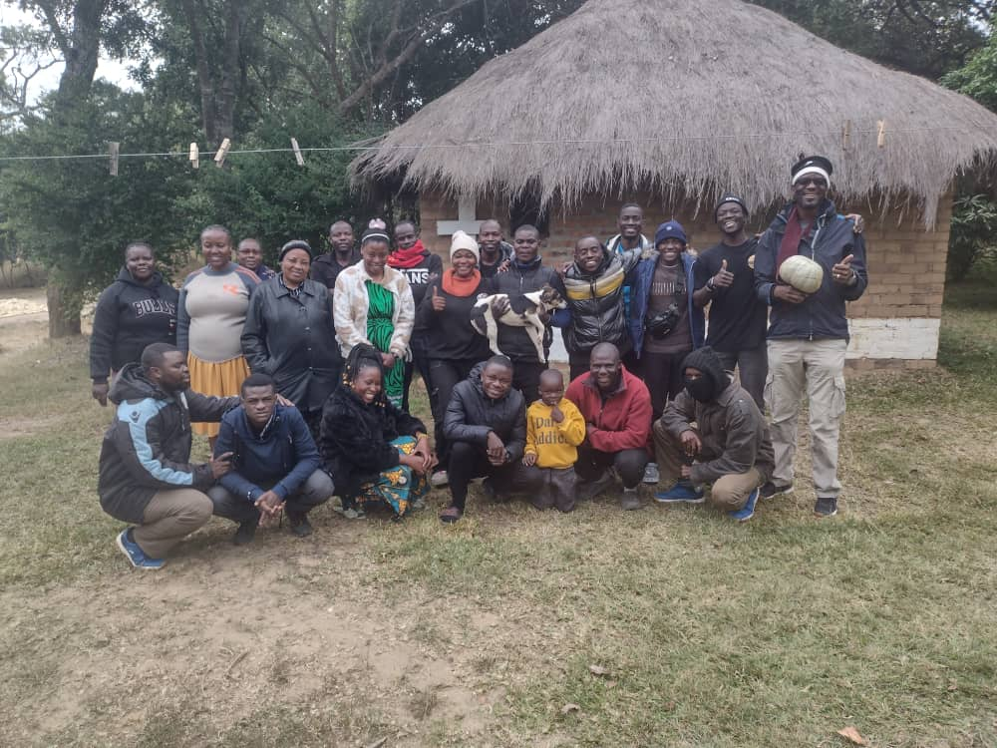
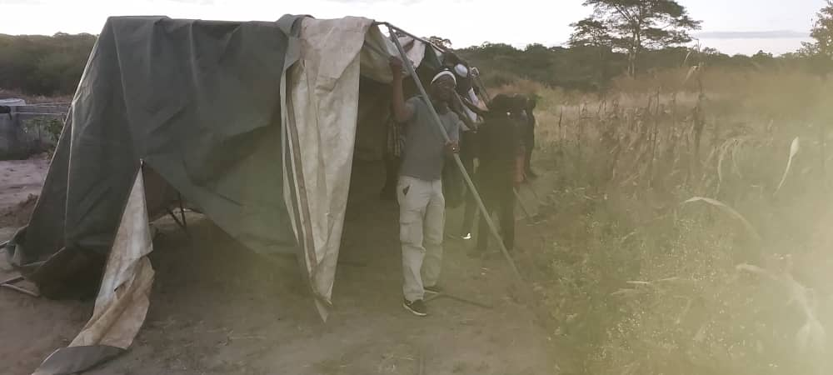
Zambia – Wati & nkandu
x
1. Pray for the church in Mkushi which we planted, for the leadership to lead by example and always grow in the Lord. Many people in this village still hold on to the old traditional way of worship, worshipping the spirits. | Here we were trying to put a temporary church building in Mkushi.

Slide 16
Zambia – Wati & nkandu
2. Pray for me for God's strength and guidance in June as I have been invited to Malawi to speak in a conference.
3. Pray for me for God's wisdom. A man by the name of Matthew Banda a church member in Makwati wanted to commit suicide because of marital dispute with his wife. I have started counseling sessions with them to try to help the situation.
4. Pray for us as a family that God will continue helping us to be role models in the community and Makwati church.
5. Pray for us as we have the privilege to conduct another marriage seminar in the community and we are praying that this will help many who are struggling with marriage.
6. I thank God that in Makwati church the widows and orphans are so committed to God's work, continue praying for them.
7. Pray for us at Makwati church, we are trusting God to have a sustainable project.

Slide 17
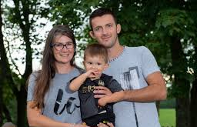
Albania
Ermal & Denisa
Pray for the children’s summer camp we are having during the last week of June. A GLO team will come from Scotland to help. We aim to reach 80-90 kids.
2. Pray for our big outreach week that will happen in Tirana where churches from all over Albania will come together and bring people who haven't heard the gospel to these events. This will be on 25-28 June.

Slide 18
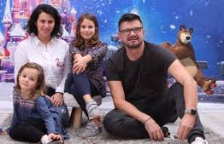
albania
Juli & Ela
1- We have the GLO Team in June when we will have a Kids Camp for 4 days with the goal of reaching 100 kids (5-10 years old)
2- At the end of June, we are having the first residential Camp (ages10-14), where we are expecting 180 pre-teens, most of them non-Christians. Please pray for this
3- In the third week of July, we have the second camp (ages14-18), and we are expecting 180 teens, most of them non-Christians.
4- Juli is going for a health check in Greece on June 6; can you keep him in your prayers that everything is well after the surgery last October?

Slide 19


